Slide 1

Bake House: Your Online Bakery Delight
This document outlines a comprehensive e-commerce bakery project that combines tradition and modernity to meet customers' needs with ease and convenience. Created by Aya Hamam Shams, Basmala Ayman Zaky, Jilan Shawky Mohamed, and Farida Mahmoud Mohamed as part of the Digital Egypt Pioneers Initiative (DEPI), the project aims to provide a seamless online experience for bakery customers through a user-friendly website design.

Slide 2
Project Overview and Objectives
The bakery project is a website that displays the various products offered by the bakery, allowing users to browse through the available types of bread and pastries. The main goal of this website is to provide a seamless and convenient experience for the bakery's online visitors, where they can learn more about the products, prices, and possibly make pre-orders or reservations. The website features a user-friendly design focused on enhancing the user experience (UX) and making it accessible across different devices through responsive design.
1
Showcase Products
2
Provide Information
Showcase the bakery's product range in a well-organized and visually appealing way.
Provide comprehensive information about the products, including prices and ingredients.
3
Improve Customer Outreach
4
Deliver Easy-to-Use Interface
Improve customer outreach online by offering flexible options such as reservations or pre-orders.
Deliver an easy-to-use interface that caters to all age groups, boosting customer loyalty and attracting new clients.

Slide 3
Target Audience and Technologies Used
Target Audience
Technologies Used
Existing bakery customers
HTML
New customers
SASS
Families and individuals
TypeScript
Business owners
Angular
Arrays for data storage
This combination of technologies ensures that the website is fast, user-friendly, and provides a smooth user experience

Slide 4
Interface Design Overview
The bakery website features a user-friendly and visually appealing interface, focusing on an enhanced user experience (UX) and easy information access. Key pages include:
Login Page Design
Home Page
Products Page
Offers Page
About Us Page
Contact Page
The design is optimized for seamless performance across devices, featuring an interactive interface powered by JavaScript for a dynamic browsing experience
Colors and Layout: Warm colors like shades of brown and beige are used for the background and buttons, reflecting the bakery's cozy and welcoming atmosphere. The page is responsive, ensuring that the content displays consistently across various devices, enhancing the user experience on both desktops and mobile devices.

Slide 5
Login and Home Page Design
The login page features a simple and clear design, using warm, inviting colors that align with the bakery's brand identity. The elements are thoughtfully arranged to enhance the user experience and make site interaction easy. Key elements include the header logo, social media links, login and register buttons, and a centered login form.
The home page represents the interface of the "Bakery House" website. It includes:
Header Section with logo, navigation menu, and user account area
Hero Section with background image, main heading, tagline, and call-to-action buttons
"Delicious Baking" Section highlighting key services and benefits
"Our Categories" Section displaying main product categories
"Our Featured Products" Section with a product carousel

Slide 6
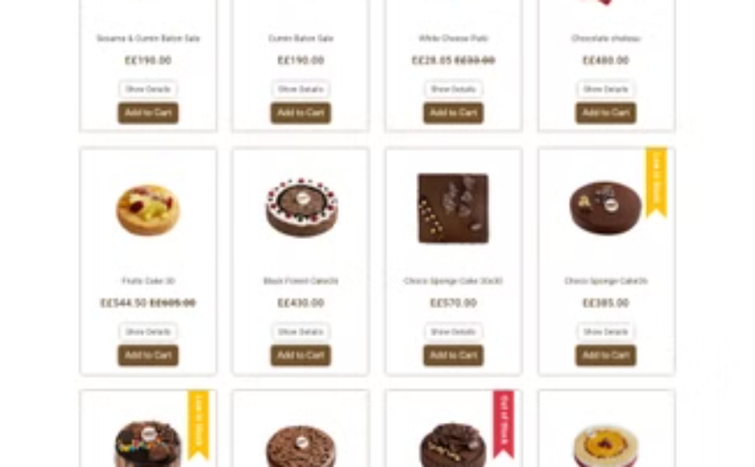
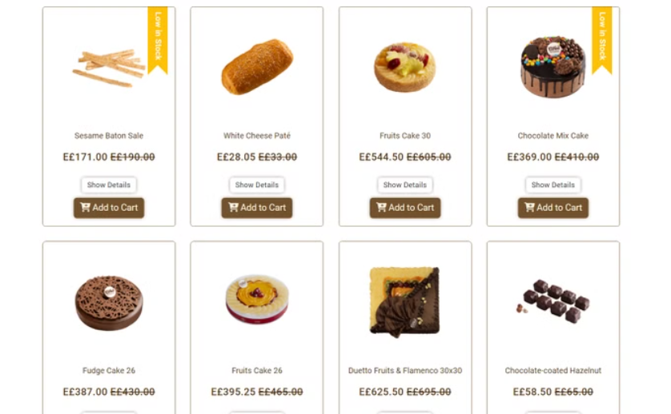
Product and Offers Page Design
Product Page
Offers Page
The product page features a grid layout with product cards displaying images, names, prices, availability status, and "Add to Cart" buttons. It includes a "Show Details" option for each product and is designed to be responsive across all devices.
The offers page displays discounted products in cards with clear pricing, availability indicators, and interactive buttons. It focuses on highlighting special deals and encouraging quick purchases.

Slide 7
About Us and Contact Page Design
The "Who Are We?" page serves as an informative section, introducing the bakery's history, values, and journey. It features:
A prominent "Who Are We?" heading
Alternating text and imagery sections
High-quality images of bakery products
Narrative text about the bakery's origin and evolution
The "Contact Us" page is designed to be simple and attractive, with a focus on ease of use and interaction. It includes:
A clear "Contact Us" heading
A simple contact form with Name, Email, and Message fields
A large, styled "Send Message" button
An attractive side image of a pink cupcake

Slide 8
Your Cart and Conclusion
The "Your Cart" page is designed for easy viewing and management of cart items. It features:
Clear product listings with images, names, prices, and quantity controls
A "Remove Product" button for each item
Total amount display
"Clear Cart" and "Proceed to Payment" buttons
In conclusion, the bakery website project emphasizes user experience and functionality, effectively reflecting the brand's identity. The intuitive interface allows users to browse products, manage their cart, and make purchases effortlessly. Key features like detailed product descriptions and user-friendly controls enhance the shopping experience, while warm colors and engaging visuals create an inviting atmosphere. User feedback will be crucial for ongoing improvements, ensuring the website remains relevant and meets evolving customer expectations. This project has been a valuable opportunity to apply design principles and web development skills in a practical context, with exciting potential for future enhancements.

